Slide 1
SAM 2: Segment Anything in Images and Videos
Authors: Nikhila Ravi, Valentin Gabeur, Yuan-Ting Hu, et al. (Meta FAIR) Source: arXiv:2408.00714v2 Core Contributors: Tengyu Ma, Christoph Feichtenhofer
Notes:
SAM 2: Segment Anything in Images and Videos,' a significant advancement from Meta FAIR. This work, spearheaded by core contributors Tengyu Ma and Christoph Feichtenhofer and a large team, aims to create a foundational model for promptable visual segmentation across both static images and dynamic video content."

Slide 2
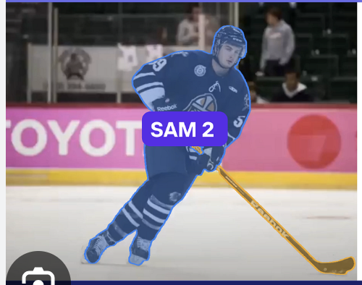
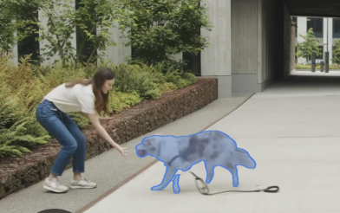
Introduction - The Challenge
Building on SAM: The original Segment Anything Model (SAM) was a breakthrough for promptable image segmentation.
The Video Frontier: Images are static; a vast amount of visual content is now video, presenting unique challenges:
Complex motion and appearance changes (deformation, occlusion, lighting).
Often lower quality (motion blur, lower resolution).
Need for efficient processing of numerous frames.
Goal: A universal visual segmentation system applicable to both images and videos.
Existing video segmentation models and datasets fall short of a "segment anything in videos" capability.
Notes:
SAM 2 is a new and smart computer program made by people at Meta FAIR.
Think of it as an updated version of an older tool called SAM (Segment Anything Model).
Its main job is to find and draw outlines around things in both pictures and videos when you ask it to.
It uses a special kind of smart thinking (called a transformer) and has a "memory" that helps it understand videos as they play, almost like watching them in real time.
Okay, let's talk about SAM 2 using very simple words.
Imagine you have a magic coloring tool for your computer. That's kind of like SAM 2.
What is SAM 2?
SAM 2 is a new and smart computer program made by people at Meta FAIR.
Think of it as an updated version of an older tool called SAM (Segment Anything Model).
Its main job is to find and draw outlines around things in both pictures and videos when you ask it to.
It uses a special kind of smart thinking (called a transformer) and has a "memory" that helps it understand videos as they play, almost like watching them in real time.
What is the purpose (the job) of SAM 2?
The main purpose is to "segment anything" – that means it can outline any object or area you point out in a picture or a video.
You can tell it what to outline by giving it "prompts," like:
Clicking on a thing.
Drawing a box around a thing.
Giving it a rough idea of the shape (a mask).
It's built to be really good with videos, understanding how things move, change shape, or even get hidden and then show up again.
This can be super helpful for things like:
Editing videos.
Helping robots "see" and understand the world.
Making cool effects for virtual reality (VR) or augmented reality (AR).
Self-driving cars.

Slide 3
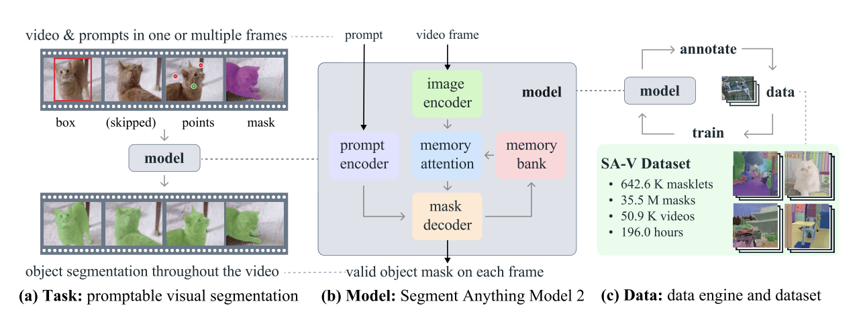
SAM 2 - Overview of Contributions
SAM 2: A unified foundation model for video and image segmentation.
Key Contributions:
Task: Promotable Visual Segmentation (PVS) - generalizing interactive segmentation to video.
Model: A simple transformer architecture with streaming memory for real-time video processing.
Data: The Segment Anything Video (SA-V) dataset, collected via a novel data engine – the largest video segmentation dataset to date.
Impact:
Video: Better accuracy, 3x fewer interactions than prior methods.
Image: More accurate and 6x faster than original SAM.
Releasing: Model, SA-V dataset, training code, and interactive demo.
Notes:
SAM 2 addresses these challenges with three core contributions, creating a unified model for both video and image segmentation.
First, the Task: They define 'Promptable Visual Segmentation' or PVS, which extends interactive segmentation to the video domain.
Second, the Model: SAM 2 employs a simple transformer architecture but critically incorporates a streaming memory for real-time video processing.
And third, the Data: A novel data engine was developed to collect the 'Segment Anything Video' or SA-V dataset, which is now the largest video segmentation dataset available. The impact is substantial: In video, SAM 2 achieves better accuracy with three times fewer user interactions. In images, it's not only more accurate but also six times faster than the original SAM. Importantly, Meta is releasing the model, the SA-V dataset, training code, and an interactive demo to the research community.

Slide 4
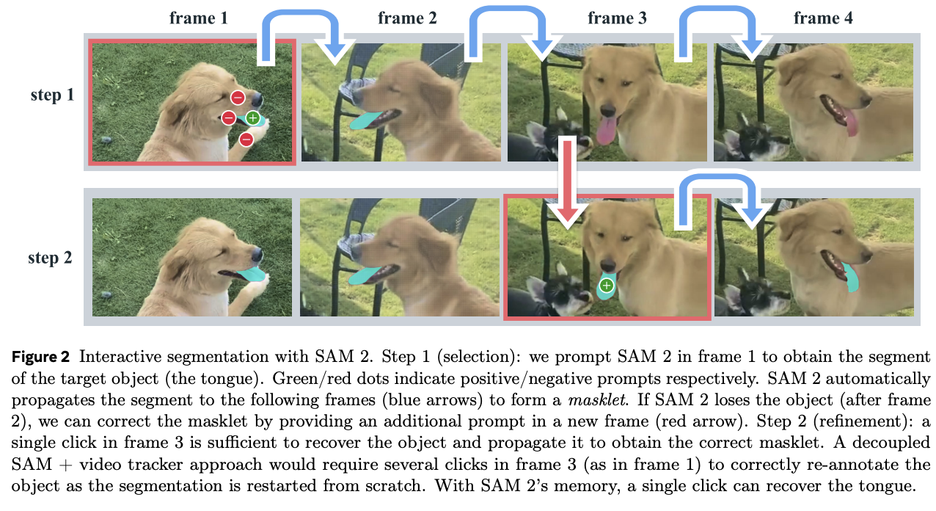
Task - Promotable Visual Segmentation (PVS)
Input: Prompts (points, boxes, or masks) on any frame of a video.
Prompts can be positive (select) or negative (exclude).
Prompts define an object of interest or refine a prediction.
Output: A spatio-temporal mask (a "masklet") for the object across the entire video.
Interactivity:
Immediate mask prediction on the prompted frame.
Propagation of segmentation to other frames.
Iterative refinement: Additional prompts on any frame can correct/improve the masklet.
Notes:
Let's delve into the Promptable Visual Segmentation task. PVS allows users to interact with a video by providing prompts – such as points, boxes, or even masks – on any frame. These prompts can be positive, to select an object, or negative, to exclude parts. The goal is for the model to then output a spatio-temporal mask, called a 'masklet,' for that object across the entire video. A key aspect is interactivity. When a prompt is given, the model provides an immediate mask on that frame. It then propagates this understanding to other frames. Crucially, PVS supports iterative refinement. If the model makes an error or loses track, the user can provide additional prompts on any frame to correct and improve the segmentation throughout the video, as shown here with the dog's tongue.

Slide 5
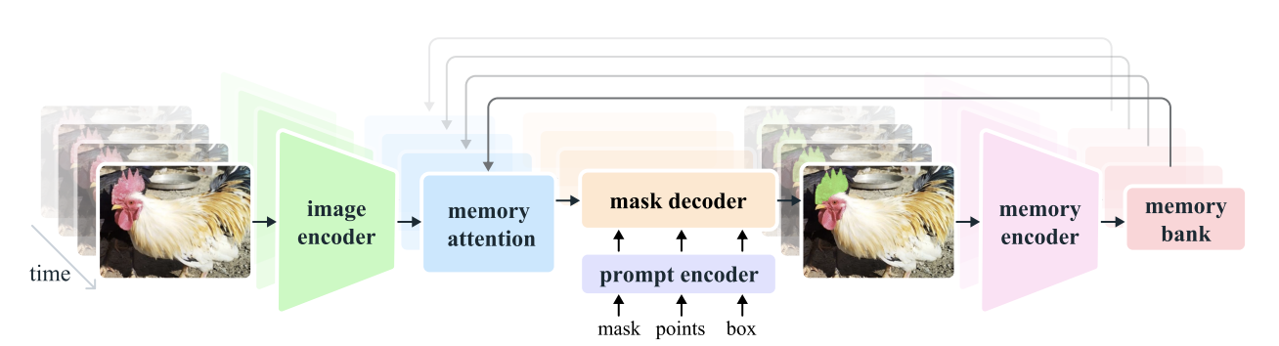
SAM 2 Model Architecture - Overview
A natural generalization of SAM to the video domain.
Processes video frames one at a time (streaming).
Equipped with a memory attention module to attend to previous memories of the target object.
When applied to images (single-frame video), memory is empty, and it behaves like SAM.
Notes:
The SAM 2 model architecture is a natural extension of the original SAM, specifically adapted for video. It processes video frames in a streaming fashion, one at a time, which is crucial for real-time applications. The key innovation for video is its memory attention module. This allows the model to attend to and utilize information about the target object from previously seen frames. When SAM 2 is applied to a single image, which can be considered a one-frame video, the memory is empty, and its behavior essentially mirrors that of the original SAM.

Slide 6
Training SAM 2
Joint Training: On both image (SA-1B subset) and video data (SA-V, Internal, public VOS datasets).
Interactive Simulation:
Samples sequences of 8 frames.
Randomly selects up to 2 frames for initial prompts (ground-truth mask, positive click, or bounding box).
Probabilistically samples corrective clicks based on model predictions vs. ground-truth masklet.
Alternating Training Strategy: Alternates batches from image and video sources to balance exposure and optimize compute.
Data Augmentation: Applied to training videos (flips, affine transforms, color jitter, mosaic).
Losses: Combination of focal & dice (mask), MAE (IoU), cross-entropy (occlusion).
Notes:
Training SAM 2 involves a joint approach using both image data, like a subset of SA-1B, and extensive video data from the new SA-V dataset, an internal dataset, and public VOS datasets. The training process simulates the interactive PVS task. Sequences of 8 frames are sampled, and up to 2 frames are randomly selected to receive initial prompts – these could be a ground-truth mask, a positive click, or a bounding box.
Then, corrective clicks are probabilistically sampled based on the model's current predictions versus the ground-truth. To efficiently use diverse data sources, an alternating training strategy is employed, switching between batches from image and video datasets. Extensive data augmentation is applied to the training videos, including flips, affine transforms, color jitter, and a mosaic transform to simulate challenging scenarios with multiple similar objects. The loss function combines focal and dice loss for the mask, MAE for IoU prediction, and cross-entropy for the new occlusion prediction.

Slide 7
Data Engine & SA-V Dataset - Motivation
Goal: To enable "segment anything" in video, a large and diverse dataset is crucial.
Data Engine:
Iterative process: Uses the model-in-the-loop with human annotators.
Improves both the model and the data over time.
Annotation Focus:
Not restricted to specific object categories.
Targets any object with a valid boundary, including whole objects and parts/subparts.
Notes:
A model is only as good as its data. To achieve the ambitious goal of 'segmenting anything' in video, a large-scale, diverse, and high-quality dataset was paramount. This led to the development of a sophisticated Data Engine.
This engine is an iterative system where the SAM 2 model itself is used in a loop with human annotators. This synergy allows for continuous improvement of both the model and the data being collected. The annotation focus was broad: not limited to predefined object categories, but aiming to segment any object with a clear boundary, including not just whole objects but also their parts and subparts.

Slide 8
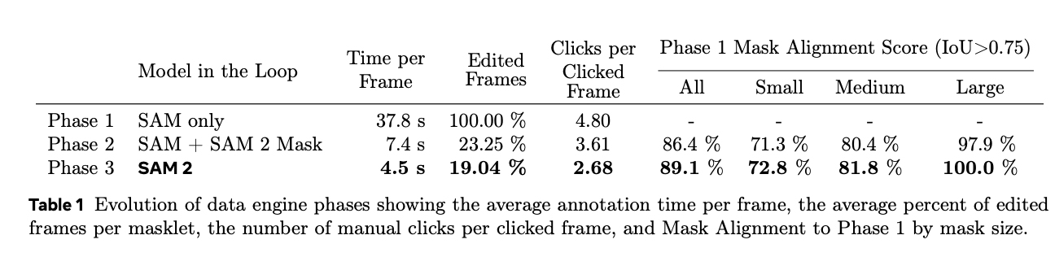
Data Engine - Phases of Development
Phase 1: SAM per frame
Used original image-based SAM for frame-by-frame annotation + manual tools.
Slow (37.8s/frame) but high-quality spatial masks.
Collected 16K masklets; used for SA-V val/test sets to mitigate SAM 2 bias.
Phase 2: SAM + SAM 2 Mask
Introduced an early SAM 2 (mask prompts only) for temporal propagation.
Annotators used SAM for initial/refined masks, SAM 2 Mask for propagation.
Faster (~7.4s/frame, 5.1x speedup). Collected 63.5K masklets.
Phase 3: Full SAM 2
Utilized the fully-featured SAM 2 (various prompts, temporal memory).
Annotators provided occasional refinement clicks.
Fastest (~4.5s/frame, 8.4x speedup vs. Phase 1). Collected 197.0K masklets.
Quality Verification: Separate annotators verified masklet quality.
Auto Masklet Generation: SAM 2 prompted with grid points to generate candidates, then verified. Increased coverage and identified model failure cases.
Notes:
Phase 1 (SAM per frame): Initially, the original image-based SAM was used for frame-by-frame annotation, supplemented by manual tools. This was slow, averaging 37.8 seconds per frame, but produced high-quality spatial masks. About 16,000 masklets were collected this way, and this method was also used for creating the SA-V validation and test sets to ensure unbiased evaluation.
Phase 2 (SAM + SAM 2 Mask): An early version of SAM 2, which only accepted masks as prompts, was introduced for temporal propagation. Annotators used SAM for initial masks, and SAM 2 Mask to propagate them, with SAM used for refinements. This significantly sped up the process to about 7.4 seconds per frame, yielding 63,500 masklets.
Phase 3 (Full SAM 2): The fully-featured SAM 2, capable of handling various prompts and leveraging its temporal memory, was deployed. This allowed annotators to refine predictions with just occasional clicks. This phase was the most efficient, at 4.5 seconds per frame – an 8.4x speedup over Phase 1 – and resulted in 197,000 masklets. A crucial part of the engine was quality verification by a separate team of annotators and an 'Auto Masklet Generation' step, where SAM 2 itself proposed segmentations that were then verified, increasing data diversity.

Slide 9
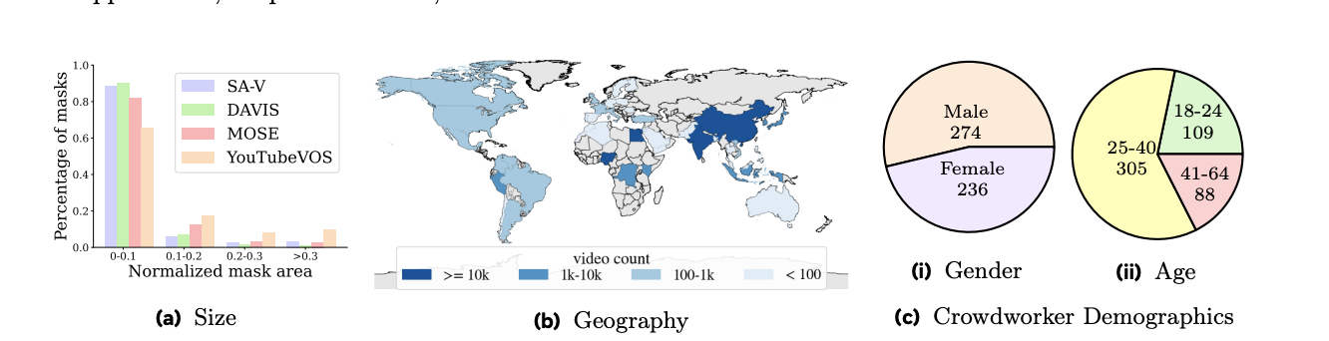
SA-V Dataset - Statistics & Diversity
Scale: 50.9K videos, 642.6K masklets (190.9K manual, 451.7K auto).
Total: 35.5 Million masks (53x more than largest existing VOS dataset).
Video Characteristics:
Newly collected by crowdworkers.
54% indoor, 46% outdoor; diverse "in-the-wild" environments.
Average duration: 14 seconds. Total 196.0 hours.
Annotation Challenges:
High "disappearance rate" (42.5% for manual masklets) - objects occluded and reappearing.
Diversity:
Geographic: Videos recorded across 47 countries.
Crowdworker Demographics: Diverse self-reported demographics.
Mask Sizes: Majority of masks are relatively small
Notes:
The resulting Segment Anything Video, or SA-V dataset, is extensive. It comprises 50,900 newly collected videos, leading to 642,600 mask lets, which translates to a staggering 35.5 million individual masks. This is over 50 times more masks than any existing Video Object Segmentation dataset. The videos themselves are diverse, captured by crowdworkers in 47 countries, covering a wide range of everyday indoor and outdoor scenarios. They average 14 seconds in duration, totaling 196 hours of footage. A key characteristic of SA-V is its difficulty; for instance, in over 42% of manually annotated masklets, the target object disappears and then reappears, testing the model's robustness to occlusion. The dataset also shows good diversity in the demographics of the crowdworkers who recorded the videos and a wide distribution of mask sizes.

Slide 10
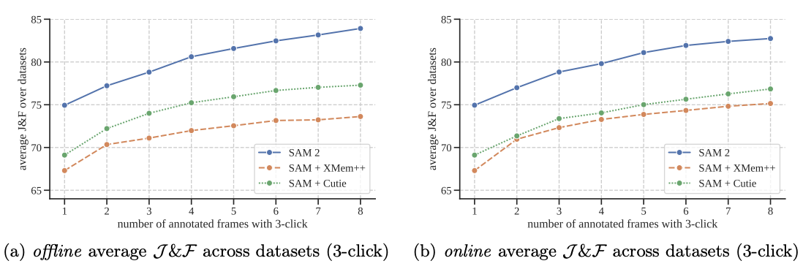
Experimental Results - Promptable Video Segmentation
Evaluation: Interactive offline (multi-pass correction) and online (single-pass correction) settings.
On 9 densely annotated zero-shot video datasets (e.g., EndoVis, LVOSv2, UVO).
Metric: J&F (Intersection over Union and Boundary F-measure).
Baselines: Strong methods created using SAM + state-of-the-art VOS models (SAM+XMem++, SAM+Cutie).
SAM 2 Performance:
Significantly outperforms baselines in both offline and online evaluations.
Achieves better segmentation accuracy with 3x fewer interactions.
Notes:
Now, let's look at SAM 2's performance. For promptable video segmentation, evaluations were conducted in both interactive offline and online settings on 9 densely annotated zero-shot video datasets. The metric used is J&F, which combines Intersection over Union and Boundary F-measure. Strong baselines were created by combining the original SAM with state-of-the-art VOS models, XMem++ and Cutie. The results are compelling: SAM 2 significantly outperforms these strong baselines in both evaluation settings. Critically, it achieves better segmentation accuracy while requiring approximately three times fewer user interactions, highlighting its efficiency and improved user experience.

Slide 11
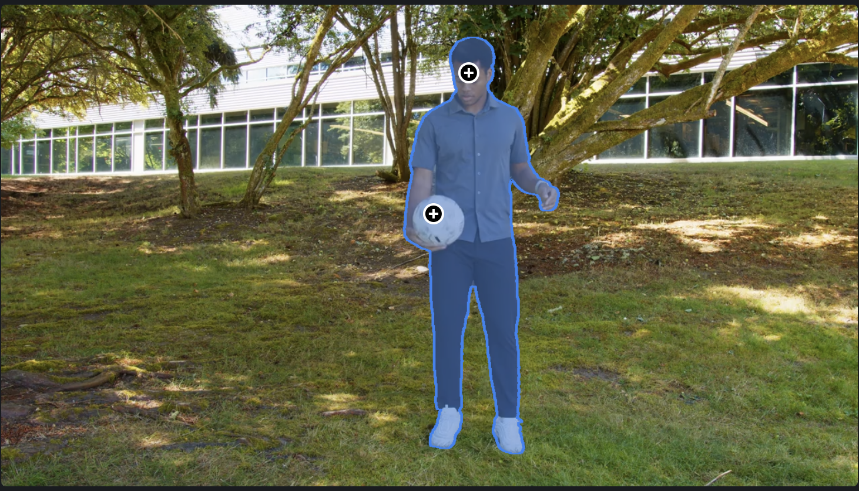
Experimental Results - Semi-supervised VOS & Image Segmentation
Semi-supervised VOS:
Prompts (clicks, box, or ground-truth mask) provided only on the first frame.
Evaluated on 17 zero-shot video datasets.
SAM 2 outperforms SAM+XMem++ and SAM+Cutie across different prompt types.
Excels even in this non-interactive VOS task for which baselines are specialized.
Image Segmentation (Segment Anything Task):
Evaluated on 37 zero-shot image datasets (23 from original SAM + 14 new video-derived).
Metric: mIoU (1-click and 5-click).
SAM 2 (Hiera-B+) vs. SAM (ViT-H) (both trained on SA-1B only):
Higher 1-click mIoU (58.9% vs. 58.1% on SA-23).
6x faster (130.1 FPS vs. 21.7 FPS).
SAM 2 (trained on image/video mix): Further boosts image mIoU to 61.9% (SA-23).
Notes:
SAM 2 also excels in more traditional tasks. In Semi-supervised Video Object Segmentation, where prompts are given only on the first frame, SAM 2 outperformed the SAM+XMem++ and SAM+Cutie baselines across 17 zero-shot video datasets, regardless of whether the prompt was clicks, a box, or a ground-truth mask. This demonstrates its strength even in non-interactive VOS scenarios. For Image Segmentation, evaluated on the Segment Anything task across 37 datasets, SAM 2 with its Hiera-B+ encoder, even when trained only on SA-1B, achieved a higher 1-click mIoU than the original SAM with its larger ViT-H encoder. Remarkably, it did this while being 6 times faster. When SAM 2 is trained on the full mix of image and video data, its image segmentation accuracy is further boosted, showcasing the benefits of joint training.

Slide 12
Conclusion
SAM 2: A Major Leap Forward
Successfully extends the "Segment Anything" paradigm to the video domain while also enhancing image segmentation capabilities.
Represents a significant step towards a universal, promptable visual segmentation system.
Key Innovations & Contributions:
Promptable Visual Segmentation (PVS) Task: A unified interactive framework for images and videos.
Advanced Model Architecture: Transformer with streaming memory effectively handles temporal dynamics in videos.
SA-V Dataset: The largest and most diverse video segmentation dataset to date, created via an innovative data engine, crucial for robust training.
Demonstrated Impact:
Video: Better accuracy with significantly fewer user interactions (3x less) compared to previous methods.
Image: More accurate and substantially faster (6x) than the original SAM.
Advances the capability to segment "anything," including objects and parts, across diverse scenarios.
Notes:
In conclusion, SAM 2 represents a significant and natural evolution of the Segment Anything paradigm, successfully extending its powerful promptable segmentation capabilities into the complex domain of video. Its key contributions are the refined Promptable Visual Segmentation task which unifies interactive segmentation for images and videos; the innovative model architecture featuring streaming memory to effectively handle temporal dynamics; and the creation of the large-scale, diverse SA-V dataset, collected via an innovative data engine, which is crucial for robust training and benchmarking. SAM 2 marks a substantial advancement in visual perception. Meta FAIR is releasing the model, the SA-V dataset, and code, and it's hoped that these contributions will serve as milestones to propel further research and a wide array of new applications in both image and video understanding.

